Slide 3
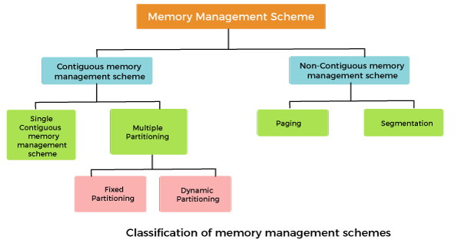

Slide 4
Non-Contiguous memory management schemes:
In a Non-Contiguous memory management scheme, the program is divided into different blocks and loaded at different portions of the memory that need not necessarily be adjacent to one another.
This scheme can be classified depending upon the size of blocks and whether the blocks reside in the main memory or not.

Slide 5
What is paging?
Paging is a technique that eliminates the requirements of contiguous allocation of main memory.
In this, the main memory is divided into fixed-size blocks of physical memory called frames.
The size of a frame should be kept the same as that of a page to maximize the main memory and avoid external fragmentation.

Slide 6
Advantages of paging:
Pages reduce external fragmentation.
Simple to implement.
Memory efficient.
Due to the equal size of frames, swapping becomes very easy.
It is used for faster access of data.

Slide 7
Page Fault:
A Page Fault occurs when a program running in CPU tries to access a page that is in the address space of that program, but the requested page is currently not loaded into the main physical memory, the RAM of the system.

Slide 8
Common Page Replacement Techniques
First In First Out (FIFO)
Optimal Page replacement
Least Recently Used (LRU)
Most Recently Used (MRU)

Slide 9
Page Replacement
Page replacement is needed in the operating systems that use virtual memory using Demand Paging.
As we know in Demand paging, only a set of pages of a process is loaded into the memory.
This is done so that we can have more processes in the memory at the same time.

Slide 10
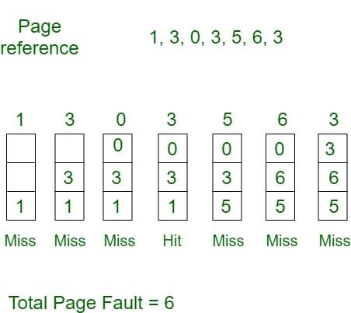

Slide 11
Initially, all slots are empty, so when 1, 3, 0 came they are allocated to the empty slots —> 3 Page Faults.
when 3 comes, it is already in memory so —> 0 Page Faults. Then 5 comes, it is not available in memory, so it replaces the oldest page slot i.e 1. —> 1 Page Fault. 6 comes, it is also not available in memory, so it replaces the oldest page slot i.e 3 —> 1 Page Fault. Finally, when 3 come it is not available, so it replaces 0 1-page fault.

Slide 12
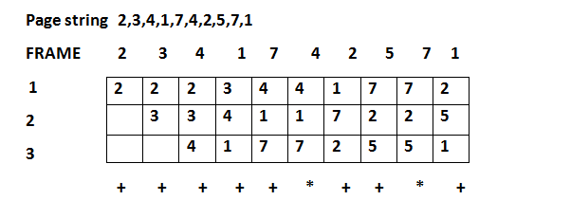

Slide 13
Hit and Miss Ratios
A hit ratio is a calculation of cache hits, and comparing them with how many total content requests were received.
A miss ratio is the flip side of this where the cache misses are calculated and compared with the total number of content requests that were received.

Slide 14
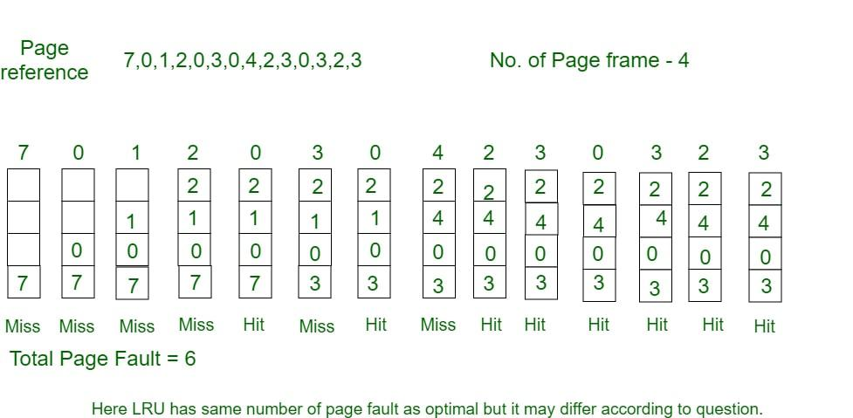

Slide 16
Least Recently Used (LRU)
In this algorithm, page will be replaced which is least recently used.
Example Consider the page reference string 7, 0, 1, 2, 0, 3, 0, 4, 2, 3, 0, 3, 2, 3 with 4-page frames. Find number of page faults using LRU Page Replacement Algorithm.

Slide 18
Most Recently Used (MRU)
In this algorithm, page will be replaced which has been used recently. Belady’s anomaly can occur in this algorithm.

Slide 19
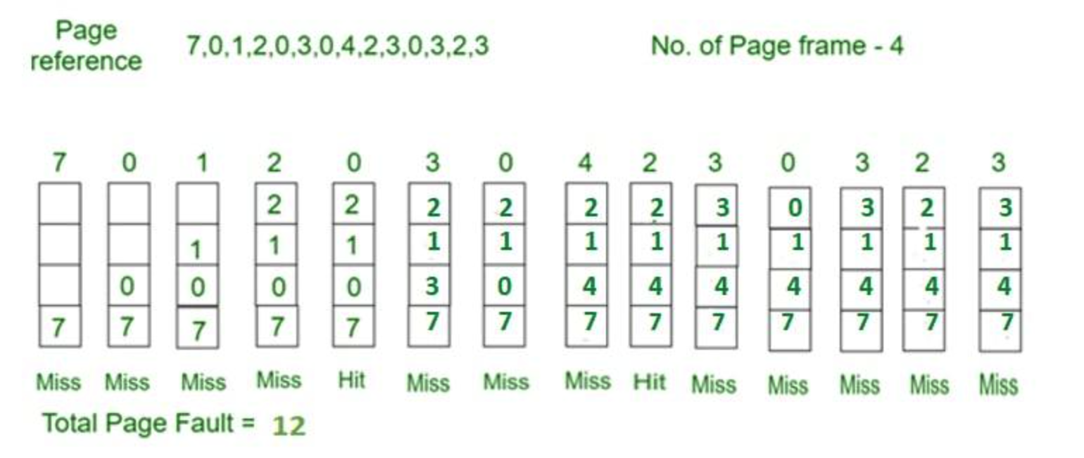

Slide 20
Belady’s Anomaly
Belady’s Anomaly is a phenomenon in operating systems where increasing the number of page frames in memory leads to an increase in the number of page faults for certain page replacement algorithms.

Slide 21
Reason for Belady’s Anomaly
Belady’s Anomaly happens because algorithms like FIFO replace pages based on their arrival order, without considering how often or soon they will be used again. Adding more frames can change the replacement order, causing frequently used pages to be evicted earlier and increasing page faults. This occurs due to the lack of awareness of future page references and the non-optimal nature of such algorithms.

Slide 22
Algorithms like Optimal and LRU (Least Recently Used) avoid Belady’s Anomaly because:
They consider the future or past usage of pages.
They use a stack-based structure, ensuring that pages in smaller frame setups will also be present in larger setups, preventing anomalies.

Slide 24
Optimal Page Replacement Algorithm
Optimal Page Replacement is one of the Algorithms of Page Replacement. In this algorithm, pages are replaced which would not be used for the longest duration of time in the future.
The idea is simple, for every reference we do following:
If referred page is already present, increment hit count.
If not present, find if a page that is never referenced in future. If such a page exists, replace this page with new page. If no such page exists, find a page that is referenced farthest in future. Replace this page with new page.

Slide 25
Example 1:
Consider the page references 7, 0, 1, 2, 0, 3, 0, 4, 2, 3, 0, 3, 2, 3 with 4-page frame. Find number of page fault using Optimal Page Replacement Algorithm.

Slide 26
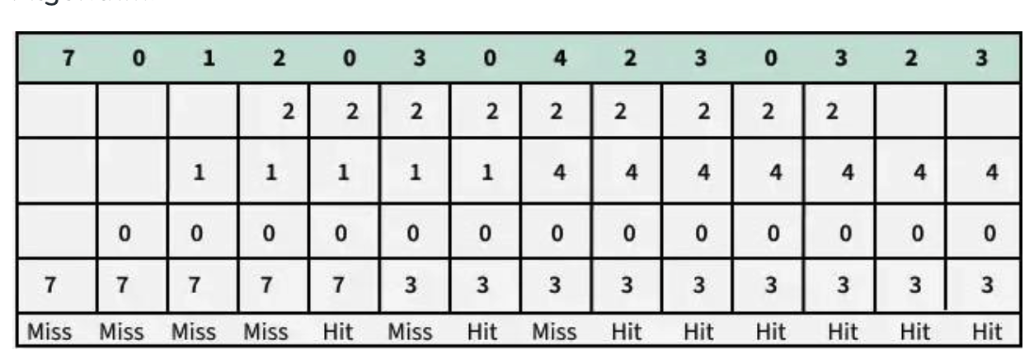
Example 1: Consider the page references 7, 0, 1, 2, 0, 3, 0, 4, 2, 3, 0, 3, 2, 3 with 4-page frame. Find number of page fault using Optimal Page Replacement Algorithm.

